Slide 1


Tyler’s Powerpoint
By: Tyler

Slide 2

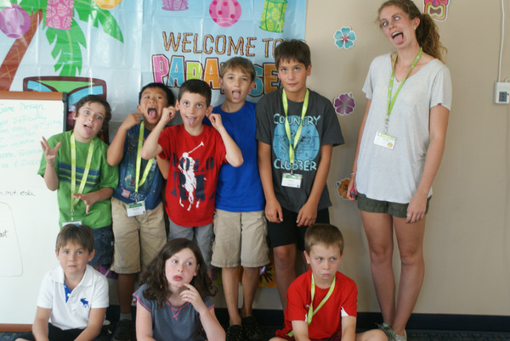
University Name Here
Robot Class
Type Camp Dates Here (ex: June 22nd – June 27th)

Slide 3

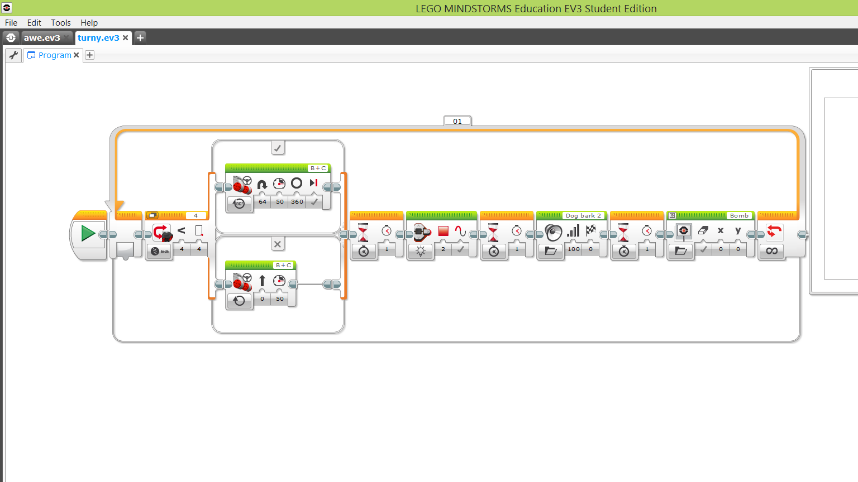
I learned to program on the brick
Replace this image with your own screenshot. Then delete this text.
To replace image: Right click and choose “Change Picture”.
I learned to use sensors
Optional Additional Text
If you want to write some more, type it here. Have fun! If you want to write some more, type it here. Have fun!
If you want to write some more, type it here. Have fun! If you want to write some more, type it here. Have fun!
If you want to write some more, type it here. Have fun!

Slide 4
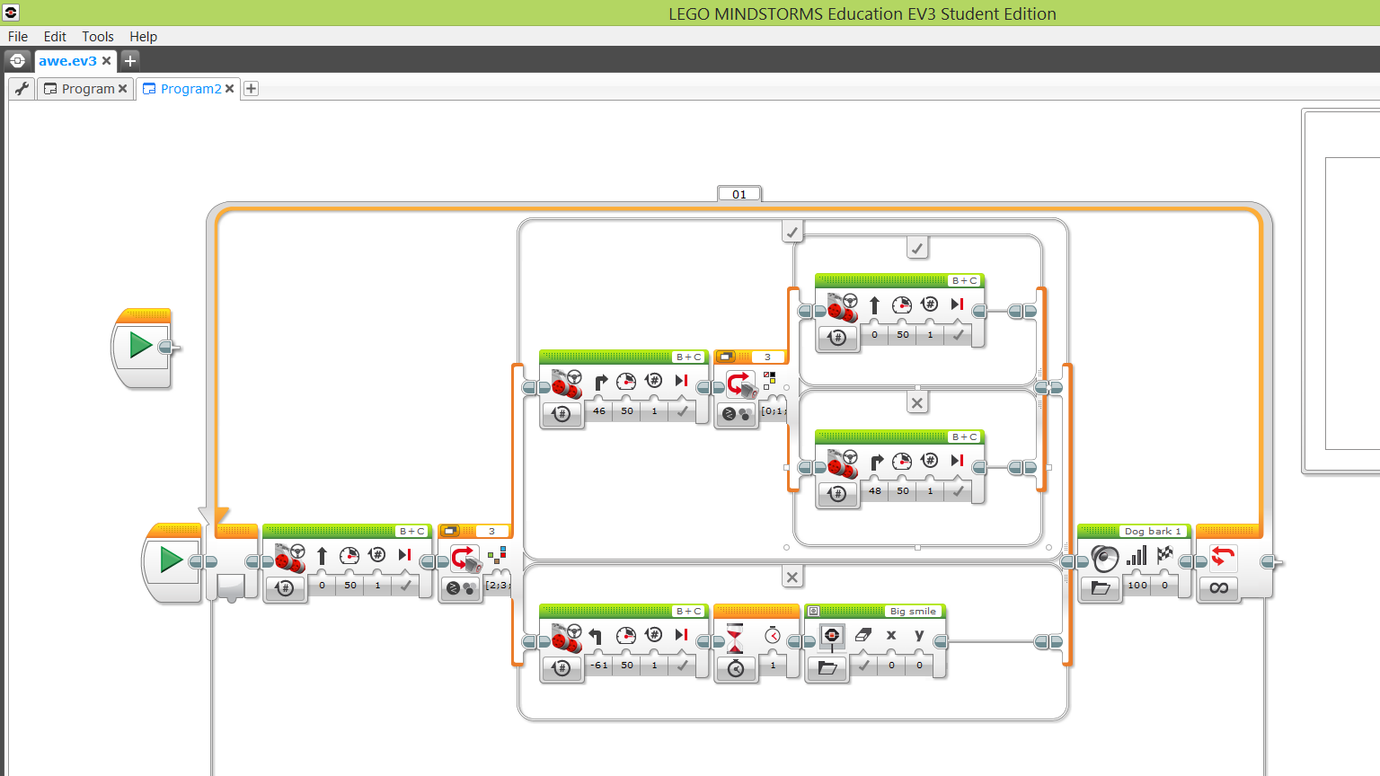
I learned to make my robot follow a line on the floor
I learned to download programs
Optional Additional Text
If you want to write some more, type it here. Have fun! If you want to write some more, type it here. Have fun!
If you want to write some more, type it here. Have fun! If you want to write some more, type it here. Have fun!
If you want to write some more, type it here. Have fun!

Slide 5
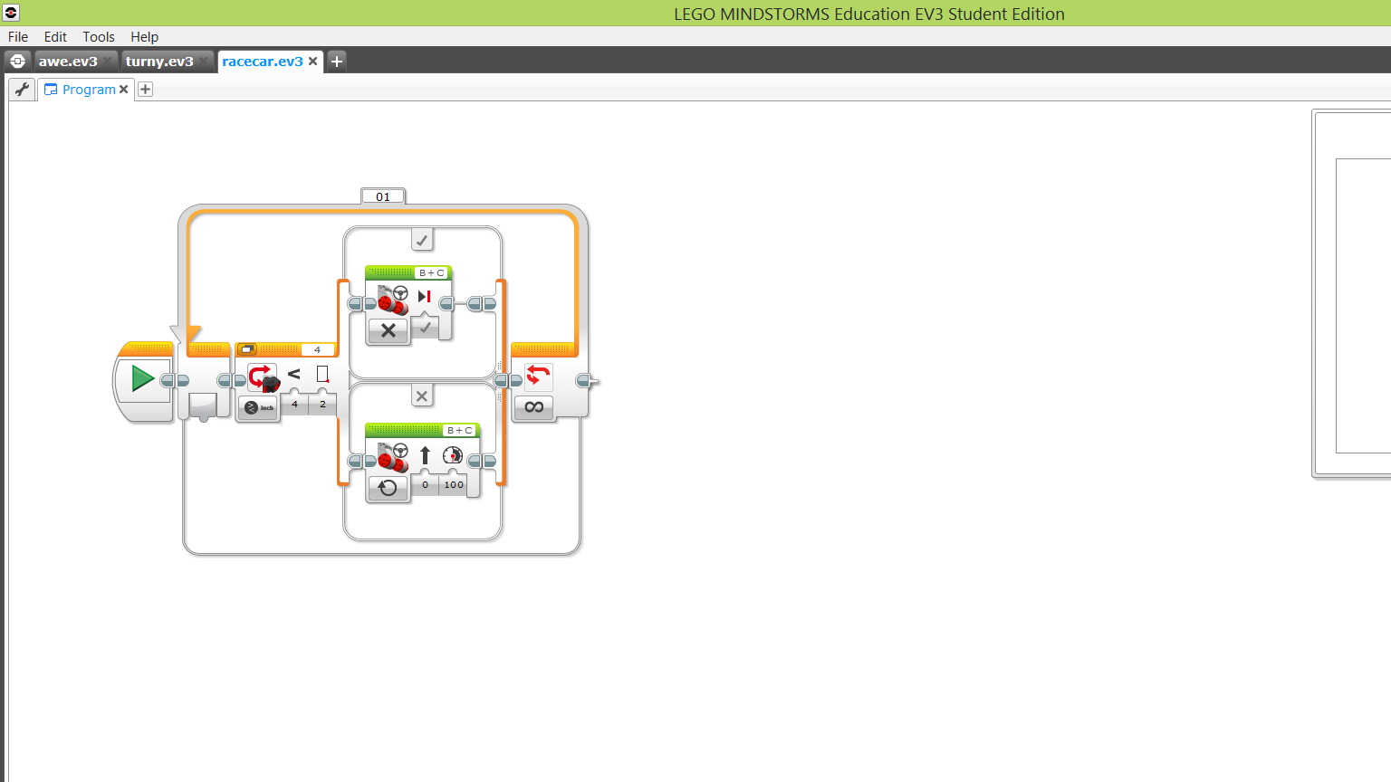
I learned to use image editor
I learned to use sound editor
Optional Additional Text
If you want to write some more, type it here. Have fun! If you want to write some more, type it here. Have fun!
If you want to write some more, type it here. Have fun! If you want to write some more, type it here. Have fun!
If you want to write some more, type it here. Have fun!

Slide 6
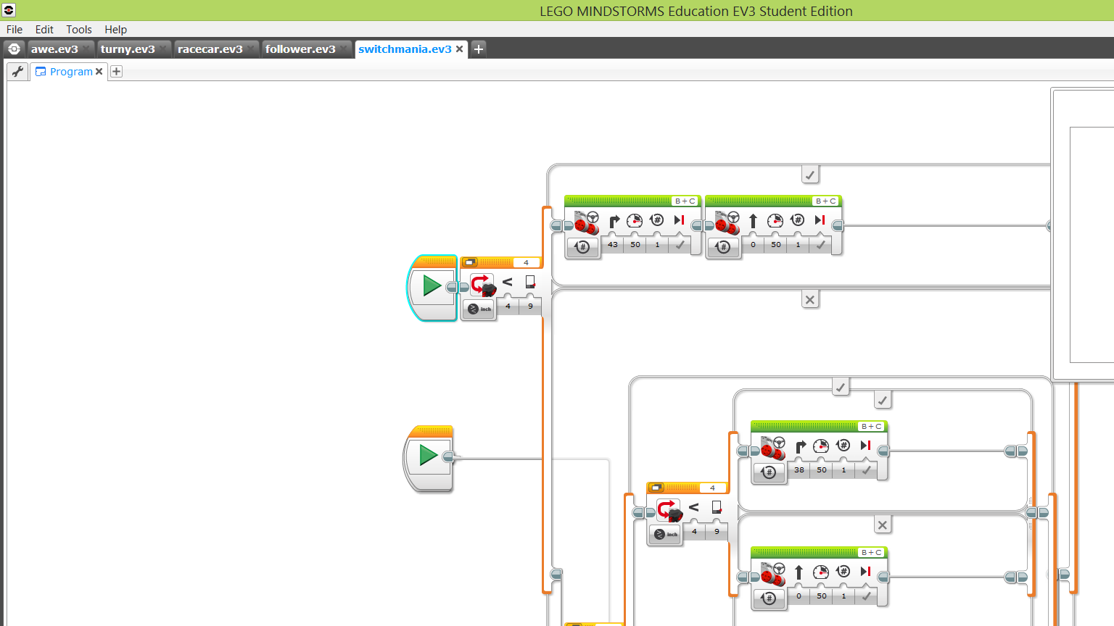
I learned to build a robot
I learned to program on the computer
Optional Additional Text
If you want to write some more, type it here. Have fun! If you want to write some more, type it here. Have fun!
If you want to write some more, type it here. Have fun! If you want to write some more, type it here. Have fun!
If you want to write some more, type it here. Have fun!

Slide 7
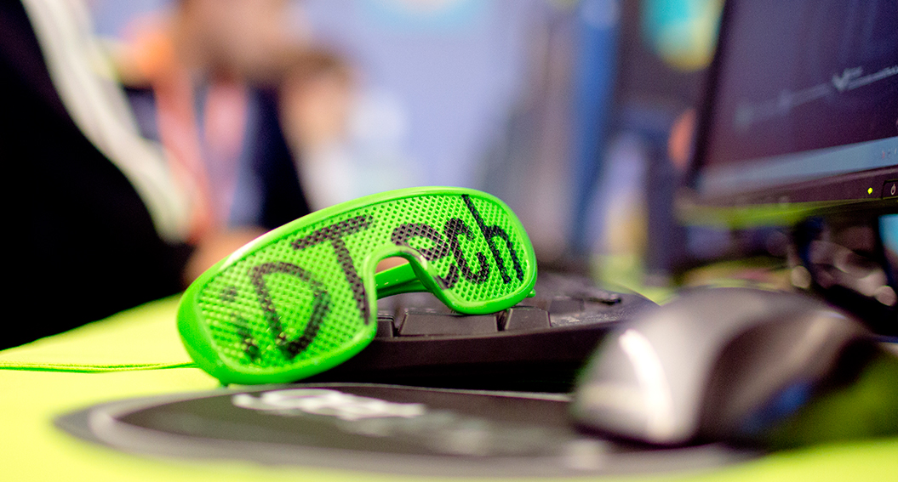
Favorite Camp Memory
I like all programing but I love hour
of code

